Slide 1

Climate Story
Presented by team ORBITON

Slide 2
What is Climate Change?
Climate change refers to the long-term shift in global weather patterns and temperatures. It is primarily driven by the increasing concentration of greenhouse gases in the Earth's atmosphere, resulting in a warming effect. This warming effect leads to various changes, including rising sea levels, melting glaciers, and more frequent and intense extreme weather events.
Natural Climate Fluctuations
Anthropogenic Climate Change
While human activities are the primary driver of current climate change, the Earth's climate has naturally fluctuated over geological time scales. These fluctuations are driven by factors such as volcanic eruptions, solar radiation variations, and Earth's orbital changes.
Since the Industrial Revolution, human activities, particularly the burning of fossil fuels, have released massive amounts of greenhouse gases into the atmosphere. These gases trap heat, leading to a significant warming effect that has accelerated climate change beyond natural fluctuations.

Slide 3
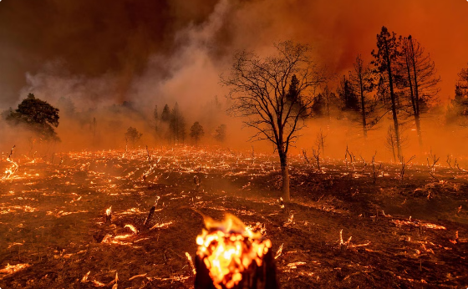
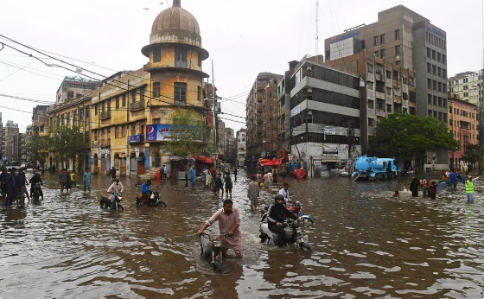
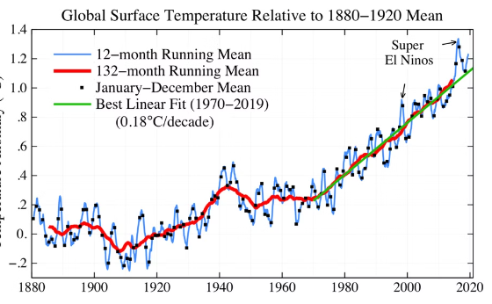
Climate Story of 2023
Record-Breaking Heatwaves
Devastating Floods
Continued Warming Trend
2023 saw scorching heatwaves across Europe and North America, leading to wildfires and health issues. The intense heat broke temperature records in numerous locations, exceeding previous highs by significant margins. These heatwaves had a devastating impact, igniting wildfires that ravaged forests and destroyed homes, while also leading to heat-related illnesses and deaths.
Monsoon rains caused catastrophic flooding in regions like Pakistan and India, displacing millions. These floods were the result of heavy monsoon rains that exceeded historical averages, leading to widespread inundation and destruction. Millions of people were displaced from their homes, and infrastructure was severely damaged. The floods caused significant economic losses and disruptions to daily life, highlighting the vulnerability of these regions to extreme weather events.
Global average temperatures continued to rise, exceeding pre-industrial levels. This continued warming trend underscores the urgent need for global action to mitigate climate change. The rising temperatures are contributing to the severity of extreme weather events, melting glaciers, and rising sea levels, which are having a profound impact on ecosystems, economies, and human societies.

Slide 4
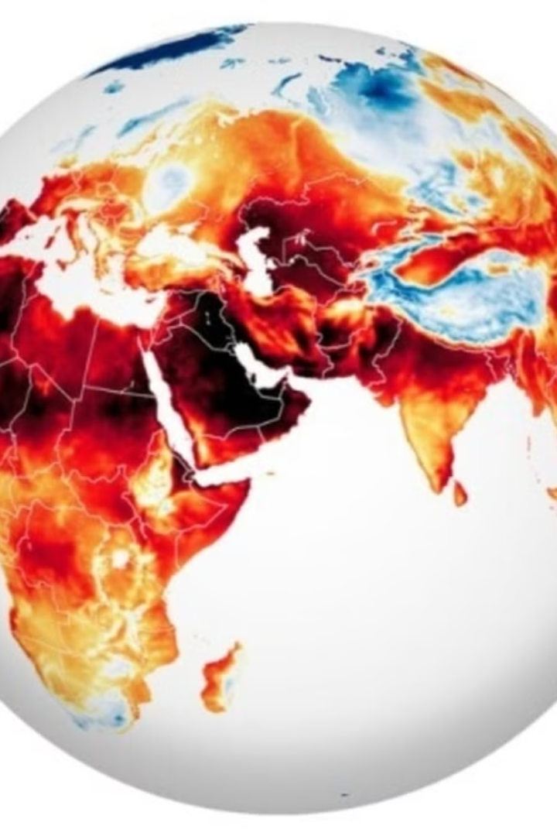
Why 2023 Was a Year of Climate Change
2023 was the warmest year in the 174-year observation record. Record-breaking heatwaves, devastating floods, and continued warming trends highlighted the urgency of addressing climate change. These events demonstrated the real-world consequences of climate change and reinforced the need for immediate action. The impacts of climate change were felt across the globe, affecting millions of people and ecosystems. The urgency of addressing climate change became increasingly apparent in 2023, as the consequences of inaction became undeniable. From scorching heatwaves to catastrophic floods, the year showcased the devastating effects of a warming planet. The need for global cooperation and decisive action to mitigate climate change has never been more pressing.

Slide 5
Website on Climate Change
Our website serves as a comprehensive resource dedicated to raising awareness about climate change and promoting sustainable practices. It features:
Educational Content: Clear explanations of climate science, causes, and impacts.
Solutions & Actions: Practical steps individuals and communities can take to combat climate change, including renewable energy options and conservation tips.
Current News: A regularly updated blog with the latest developments in climate science and policy.
Interactive Tools: Engaging resources like carbon footprint calculators and quizzes to enhance user understanding.
Community Engagement: Opportunities for users to get involved through volunteering, petitions, and local initiatives.
By providing accessible information and encouraging action, our website aims to empower individuals and communities to contribute to a sustainable future.

Slide 6

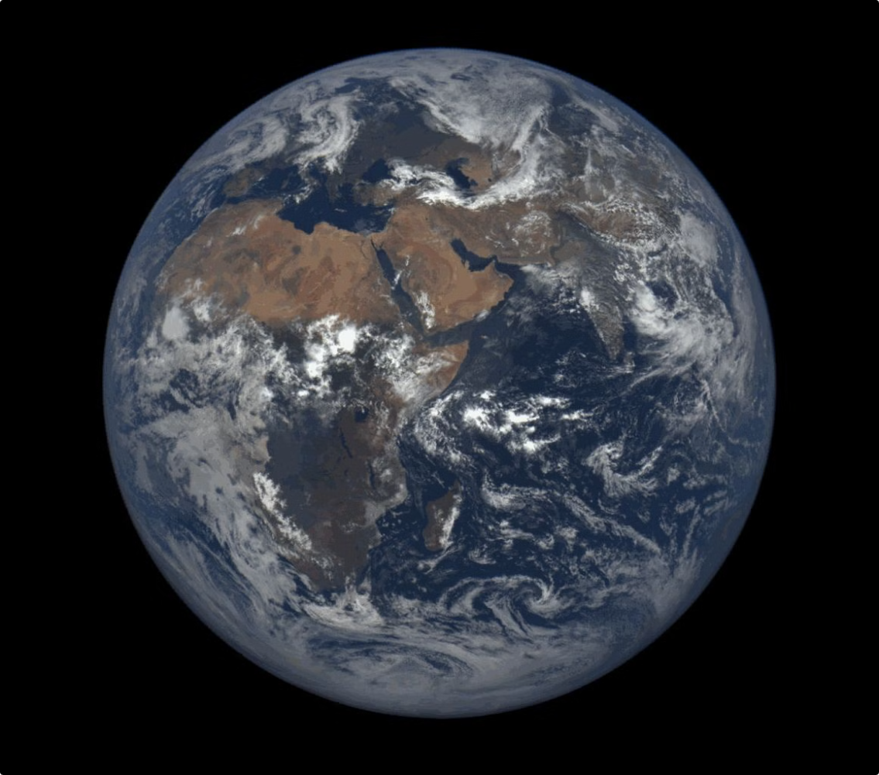
Conclusion and Call to Action
Climate change is a pressing global challenge that demands immediate action. The choices we make today will determine the future of our planet and the well-being of generations to come. It is crucial that we embrace sustainable practices, reduce our reliance on fossil fuels, and invest in clean energy technologies.
The time for complacency is over. We must act now to mitigate the impacts of climate change and build a more sustainable future. Individual actions can make a difference, from reducing our carbon footprint to advocating for policy changes.
Together, we can create a world where climate change is not a threat, but a challenge we have overcome. Let us all play our part in building a sustainable future for ourselves and future generations.

Slide 7


Thank You! Let Your Climate Story Be Heard
Climate change is a pressing global challenge that demands immediate action. By sharing your Climate Story on this website, you can help raise awareness and inspire others to take action.
"YOUR CLIMATE STORY MATTERS!!!"

